Slide 1
Chemical Formulas

Slide 2
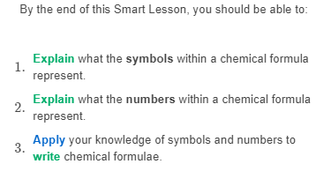

Slide 3
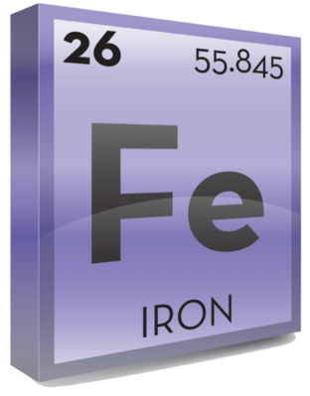
The best way to figure out the chemical symbol for an element is to check the periodic table.
So, let's say we want to know the symbol of iron. We look through the periodic table until we find iron's square, pictured below.

Slide 4
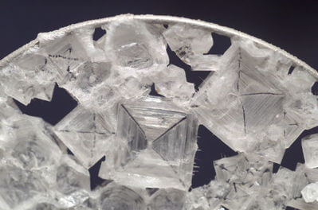
It can take a long time to explain the composition of compounds.
We can say "salt molecules contain one sodium atom and one chlorine atom" or "sand has a ratio of one silicon atom to every two oxygen atoms".

Slide 5
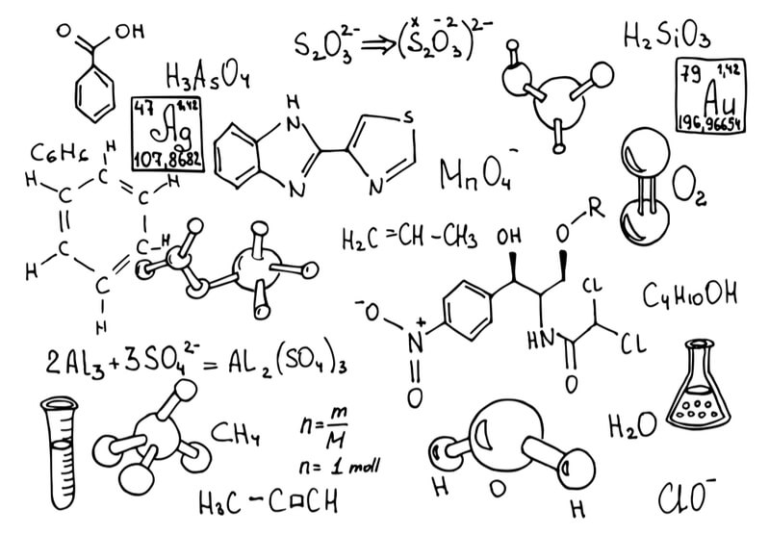
In chemistry, we use a shorthand called a chemical formula.
The formula lists every atom in the molecule and states how many atoms there are.
This gives us a quick way to figure out exactly what is in a compound.

Slide 6
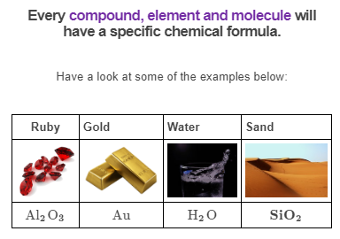

Slide 7
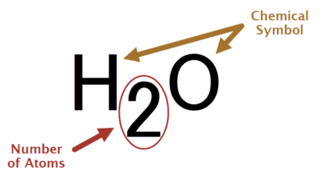
A chemical formula is a collection of symbols and numbers which represent the number of atoms in an element or compound.
We write the symbol for one element, then in subscript (on the bottom right of a symbol, as below) we write the number of atoms of that element. Then we write the next element and so on.

Slide 8

If you break down a chemical formula, you will notice that it is made up of chemical symbols from the periodic table.
The purpose of these symbols is to tell you what elements make up the compound. There are number(s) to the bottom right of each chemical symbol. These tell you how many atoms of that element are in that compound.
Remember, if there is no number, then there is only one atom.

Slide 9
Elements can also have chemical formulae.
Oxygen gas is an element, but is made up of molecules which contain two oxygen atoms. Therefore, oxygen has the chemical formula O₂​.

Slide 10

Lattices are solid, rigid structures of atoms; they can be made of single or multiple elements.
If you had a lattice of iron, the chemical formula would just be Fe. Equally, argon gas has the chemical formula Ar because the gas is made up of singular argon atoms.

Slide 11

Now that you know what a chemical formula is, you need to learn how to write one.
Special rules and conventions must be understood and followed to properly construct a formula.

Slide 12
We order the elements in a formula based on their placement in the periodic table.
Elements on the left are written before elements on the right. If the two elements are in the same column, elements on the bottom go before those on the top.
For example, the metal sodium (Na) and the non-metal chlorine (Cl) make up sodium chloride, salt. Sodium is further left than chlorine, so we write NaCl.

Slide 13
Let's look at how to write a chemical formula, using the example iron sulfate.
Step 1: Find the elements involved in the formula.
Iron sulfate contains iron, sulfur and oxygen.
Step 2: Find out how many there are of each atom.
One iron, one sulfur, four oxygen.
Step 3: Order the elements as you would find them on the periodic table from left to right.
Fe, O, S.

Slide 14
Writing chemical formula (cont.):
Step 4: If two elements are in the same column, the bottom one goes first.
Fe, S, O.
Step 5: Place the number of atoms on the bottom right (in subscript) of each element.
Fe, S, O₄​.
Step 6: Combine the pieces into a single formula:
FeSO₄​.

Slide 15

Every compound has its own chemical formula that is used to show us which elements make up the compound.
This video (0:57) summarises what we have learned about writing formulas.

